Slide 1
Employee Data Analysis using Excel
STUDENT NAME: M. KAVITHA
REGISTER NO: 312209838
NM ID: 729CE428C8D652481324E0C19992FD05
DEPARTMENT: B.COM( ACCOUNTING AND FINANCE )
COLLEGE: VALLIAMMAL COLLEGE FOR WOMEN

Slide 2

PROJECT TITLE
Employee Performance Analysis using Excel

Slide 3



AGENDA
Problem Statement
Project Overview
End Users
Our Solution and Proposition
Dataset Description
Modelling Approach
Results and Discussion
Conclusion
3/21/2024 Annual Review

Slide 4

PROBLEM STATEMENT
Analyze employee data using Excel to understand performance trends and improve decision-making. It also analyze employee data and understand performance trends.
Dates (Start and End Dates)
Supervisors- Contact Information
Employment Details (Employee Type, Pay Zone)
Employment Status (Termination)
Departments
Demographics (Birth Date, State)
Job Function
Location
Performance

Slide 5

PROJECT OVERVIEW
This project aims to analyze employment data to uncover the following:
Labor market trends,
Assess economic health, and
provide actionable insights for decision-making.
By focusing on key metrics such as :
Employment rates,
Wages level, and
Sector-specific trends over the past five years, the analysis will help identify areas for policy intervention and strategic planning.

Slide 6



WHO ARE THE END USERS?

Slide 7

OUR SOLUTION AND ITS VALUE PROPOSITION
CONDITIONAL FORMATTING:
It is used to identify the missing elements
FILTERING:
It is used to remove the unwanted elements
FORMULA:
It is used to analyze the performance level
4) GRAPH:
It is used to represent the data visualization

Slide 8
Dataset Description
This description is about employee data analysis which is done through kaggle. It has 26 total features and in this data set it has involved 6 feature which includes;
Employee ID
First Name
Last Name
Business Unit
Gender
Employee Classification
Employee Status
Employee Type
Performance Score
Performance level.

Slide 9


THE "WOW" IN OUR SOLUTION
Performance Level using formula of:
=IFS(Z8>=5,”VERY HIGH”,Z8>=4,’HIGH”,Z8>=4,”MED”,TRUE,”LOW”)
3/21/2024 Annual Review
9

Slide 10
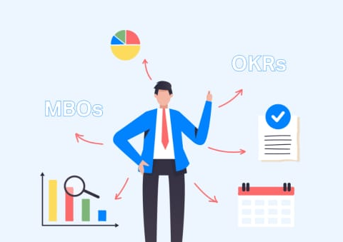
MODELLING
DATA COLLECTION:
Collection of employees Id
Collection of employees Bio reference
DATA CLEANING:
Removing duplicates
Handling missing data
Correcting errors
PERFORMANCE LEVEL:
Used formulas to identify ratings
10

Slide 11
RESULTS
ALL EMPLOYEE ANALYSIS CHART:
11

Slide 12
RESULTS
MALE EMPLOYEE ANALYSIS CHART:

Slide 13
RESULTS
FEMALE EMPLOYEE ANALYSIS CHART:

Slide 14

conclusion
In Summary, Our Employee Performance Analysis solution leverages Excel to transform complex data into actionable insights.
By organizing and summarizing performance metrics, comparing data across teams and periods and forecasting future trends, it provides a comprehensive view of employee performance.
The use of interactive dashboards and automated processes further simplifies data interpretation and decision-making.
This approach enhances productivity, improves workforce management, and supports informed strategic decisions, ultimately driving better organizational outcomes.

